Slide 1

SAY HELLO TO
Liane Stevenson @webdevelopwolf www.webdevelopwolf.com

Slide 2
INTRODUCTION
Lets get on the road…

Slide 3
WHAT DID WE DO LAST TIME?
Why design our apps?
Stages of app design
Benefits of app design

Slide 4
WHAT ARE WE DOING TODAY?
What Ionic is and does
Build our first Ionic App
How navigation works
Skeleton App

Slide 5
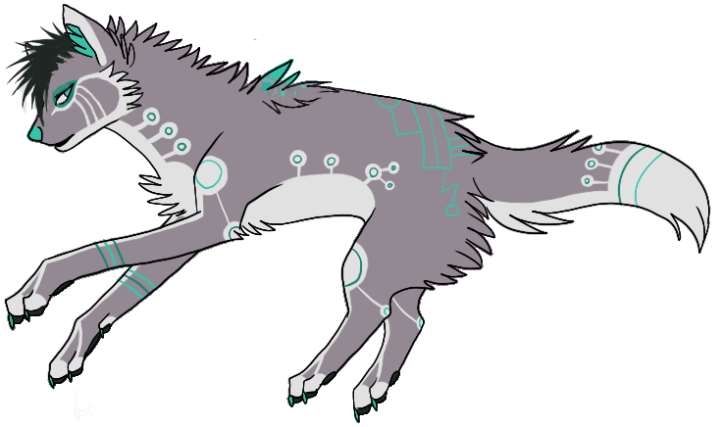
Need help?
Github:
http://www.github.com/webdevelopwolf/training
Twitter:
http://www.twitter.com/webdevelopwolf
Facebook:
http://www.facebook.com/webdevwolf
Discord:
https://discord.gg/jWGvtnZ

Slide 6
WHY IONIC?
It’s not electric, it’s supercharged!

Slide 7
What is Ionic?
“Ionic is an HTML5 mobile app development framework targeted at building hybrid mobile apps.”
From Ionic team’s documentation

Slide 8




Cool, but what’s a hybrid app?
Before Ionic, we had to build three apps in three languages (Objective C, PHP or C#).
Cordova creates a bridge between the three platforms using JavaScript, which creates our hybrid app.
So now we can make one application back-end, but we still need three different apps with three different looks.

Slide 9
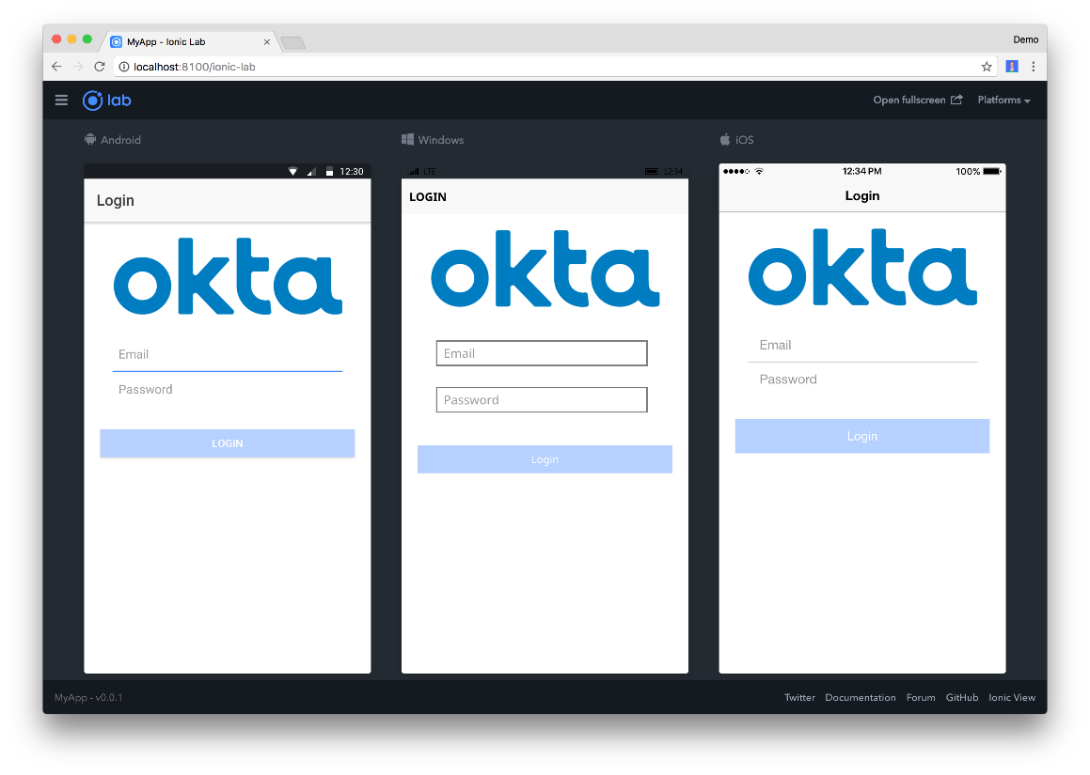
That’s where Ionic comes in…
Ionic detects the device it’s running on and styles accordingly.
Other Ionic benefits include:
Uses Angular and TypeScript
Powerful Navigation Stack
Intelligent Build System
Unrivalled Performance

Slide 10
GETTING STARTED
Let’s jump in – wheeeeeeee!

Slide 11


Installing Ionic
To install Ionic, we need to have NodeJS installed
https://nodejs.org/en/
Download and run the current version
Open Command Prompt to install Ionic using NodeJS
npm install –g ionic cordova
This is called a Command Line Interface or CLI for short

Slide 12

Starting a new project
We start a new Ionic project in two very simple steps
Open Command Prompt
Type, ionic start [project name] tabs
The CLI will place your app in the folder your Command Prompt is open in at the time the command is run.
To change, type cd C:\Folder BEFORE, running your ionic start command
You can see a full list of Ionic commands by typing ionic in the command line

Slide 13
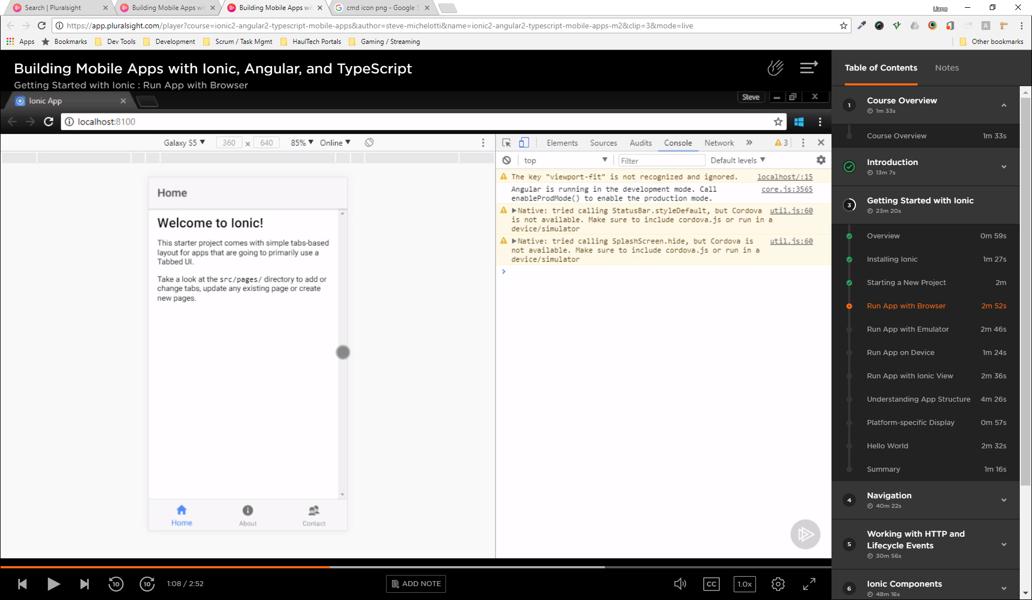
Run application in the browser
We can already see what our new app looks like using the command ionic serve
This opens your default browser to http://localhost:0000 and displays your mobile app
If we press F12 and click the Mobile View Toggle we can see the app as on your favoured mobile device.

Slide 14
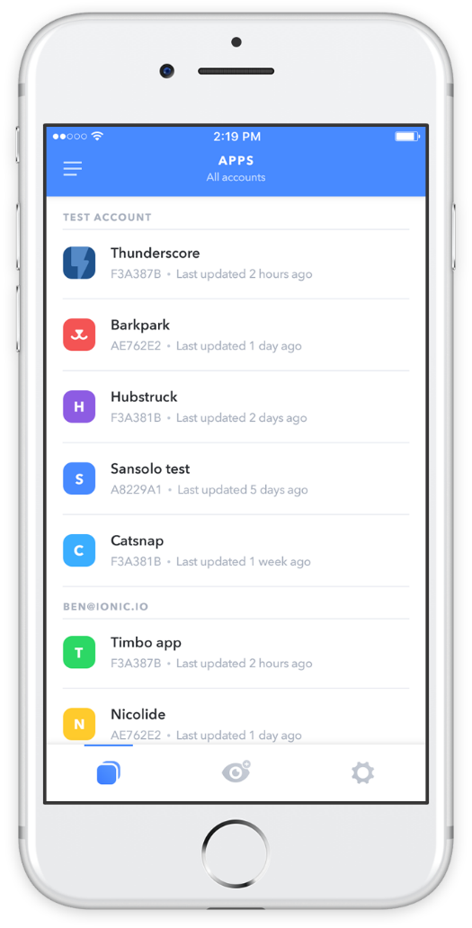
Run application on a mobile
You may need to run your application on a mobile device for things like:
Using the camera
Scanning QR or Barcodes
Accessing anything else that uses features native to the phones OS
We can find out how to do this at: https://ionicframework.com/pro/view

Slide 15

Argh! What’s all these files and folders?
Even a small mobile app has a large folder structure, it’s not as confusing as it first seems.
The src folder is where it’s all at. This is the folder we’re going to live in when developing our app.
The whole app runs from a single page, index.html, using the <ion-app> tag as a container.
The app folder is our starting point and contains all our configuration:
Sections (or modules)
Plug-ins
Services
Etc.
The pages folder is each section we create and each has three parts:
HTML (.html) – Front-end
CSS (or SCSS) - Styling
TypeScript (.ts) – Back-end
The www folder contains very little now, but when we build our app, it will be stored here.
Any assets we use in our app should be copied in the assets folder.

Slide 16
NAVIGATION
Bring your map and be prepared to ask for directions!

Slide 17

The Navigation Stack
Ionic is creating a stack of pages as we move around the app
Newly opened pages get pushed onto the stack
When we hit the back button, the last page is popped off the stack
Ionic does support more than one stack

Slide 18

Creating an app skeleton
We can now build a ‘skeleton’ app so we can see how we will navigate around. First of all we need some pages.
Ionic generate page [name] –no-module
We do this for each page we want to create in our application and add tell Ionic that they are there. Finally we’ll put some links in…

Slide 19
Using The Navigation Stack
We add and remove items to and from the navigation stack with the help of the NavController.
This is pre-imported into pages generated in Ionic using the CLI.
We create our own instance of the NavController and push the page we want to navigate to onto the stack, like so…
We already have a back button that returns us to the home page. To mimic this behaviour we can pop the current page off the stack like how we pushed the page onto the stack

Slide 20
WHAT DID WE LEARN THIS TIME?
Finding out what Ionic is and does
Starting our first Ionic Mobile App
Looking at how navigation works in Ionic
Creating a skeleton app

Slide 21
THIS TIME’S CHALLENGE!
Build a menu screen that links to all of the pages you have created
For bonus points, expand your application:
Create a new page
Declare this page in the app config
Link to it from your menu

Slide 22
Need help?
Github:
http://www.github.com/webdevelopwolf/training
Twitter:
http://www.twitter.com/webdevelopwolf
Facebook:
http://www.facebook.com/webdevwolf

Slide 23

NEXT SECTION…
We’re going to be putting together a slick-looking slide-in navigation menu in Ionic and starting to look at putting a few Ionic components in our app such as lists, tabs and more! And we’ll be styling our app along the way! ☺

